Slide 1
Overview of testing, test levels, test scenarios and test cases
Software Testing

Slide 2
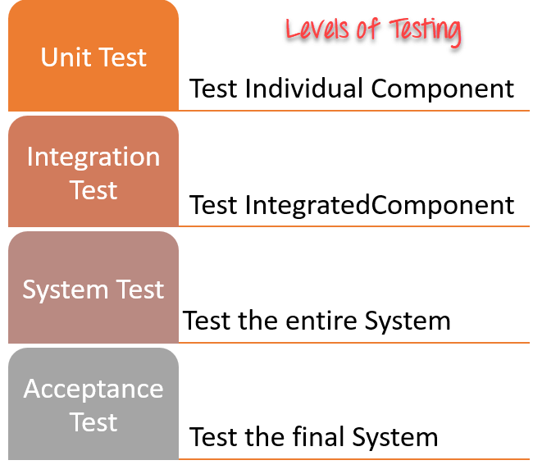
Levels of testing

Slide 3
S O U R C E S O F I N F O R M A T I O N F O R T E S T C A S E S E L E C T I O N
Designing test cases has continued to stay in the attentions of the research community
and the practitioners.
Requirements and functional specifications
Source code(Behavior)
Input and output domains
Operational profile( how system is sued)
Fault model(previous faults )

Slide 4
Test case
A Test Case is a set of actions executed to verify a particular feature or functionality of your software application.
The Test Case has a set test data, precondition, certain expected and actual results developed for specific test scenario to verify any requirement.
A test case includes specific variables or conditions, using which a test engineer can determine as to whether a software product is functioning as per the requirements of the client or the customer.

Slide 5
A Test Scenario
A Test Scenario is defined as any functionality that can be tested.
It is a collective set of test cases which helps the testing team to determine the positive and negative characteristics of the project.
Test Scenario gives a high-level idea of what we need to test

Slide 6
Example:
Let us say that we need to check an input field that can accept maximum of 10 characters.
While developing the test cases for the above scenario, the test cases are documented the following way.
In the below example, the first case is a pass scenario while the second case is a FAIL.

Slide 7
Example
Scenario | Test Step | Expected Result | Actual Outcome
Verify that the input field that can accept maximum of 10 characters | Login to application and key in 10 characters | Application should be able to accept all 10 characters. | Application accepts all 10 characters.
Verify that the input field that can accept maximum of 11 characters | Login to application and key in 11 characters | Application should NOT accept all 11 characters. | Application accepts all 10 characters.

Slide 8
Test case
Test Case Field | Description
Test case ID: | Each test case should be represented by a unique ID. To indicate test types follow some convention like "TC_UI_1" indicating "User Interface Test Case#1."
Test Priority: | It is useful while executing the test. Low Medium High
Name of the Module: | Determine the name of the main module or sub-module being tested
Test Designed by: | Tester's Name
Date of test designed: | Date when test was designed

Slide 9
Test case
Test Executed by: | Who executed the test- tester
Date of the Test Execution: | Date when test needs to be executed
Name or Test Title: | Title of the test case
Description/Summary of Test: | Determine the summary or test purpose in brief
Pre-condition: | Any requirement that needs to be done before execution of this test case. To execute this test case list all pre-conditions
Dependencies: | Determine any dependencies on test requirements or other test cases
Test Steps: | Mention all the test steps in detail and write in the order in which it requires to be executed. While writing test steps ensure that you provide as much detail as you can
Test Data: | Use of test data as an input for the test case. Deliver different data sets with precise values to be used as an input
Expected Results: | Mention the expected result including error or message that should appear on screen

Slide 10
Test Case
Post-Condition: | What would be the state of the system after running the test case?
Actual Result: | After test execution, actual test result should be filled
Status (Fail/Pass): | Mark this field as failed, if actual result is not as per the estimated result

Slide 11
Example of test case
Doc file
Result > excel file

Slide 12
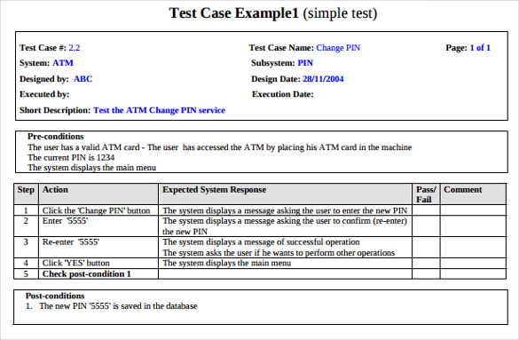
Example

Slide 13
Activity
Test scenario
Verify profile update of face book
Design a test case

